Slide 1

Understanding The Blockchain
Author: Aiden Wesley
December 7th, 2023

Slide 2
Problem and Solution
Problem – Blockchain was created so people would have a decentralized secure ledger of records.
Solution – Blockchain solves this by creating a decentralized unchangeable ledger that is publicly available.

Slide 3
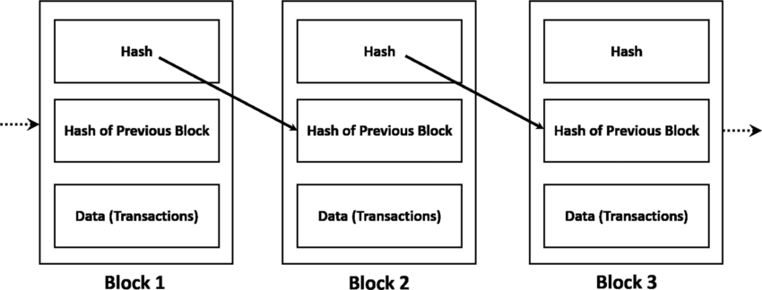
What is the Blockchain?
Blockchain Overview:
The blockchain is a decentralized ledger storing records in blocks.
Versatility Beyond Cryptocurrency:
Typically used with cryptocurrency but not limited to it.
Eliminating Intermediaries:
Enables transactions without the need for intermediaries (e.g., banks in terms of crypto).
Applicable in various industries for secure and transparent transactions.

Slide 4
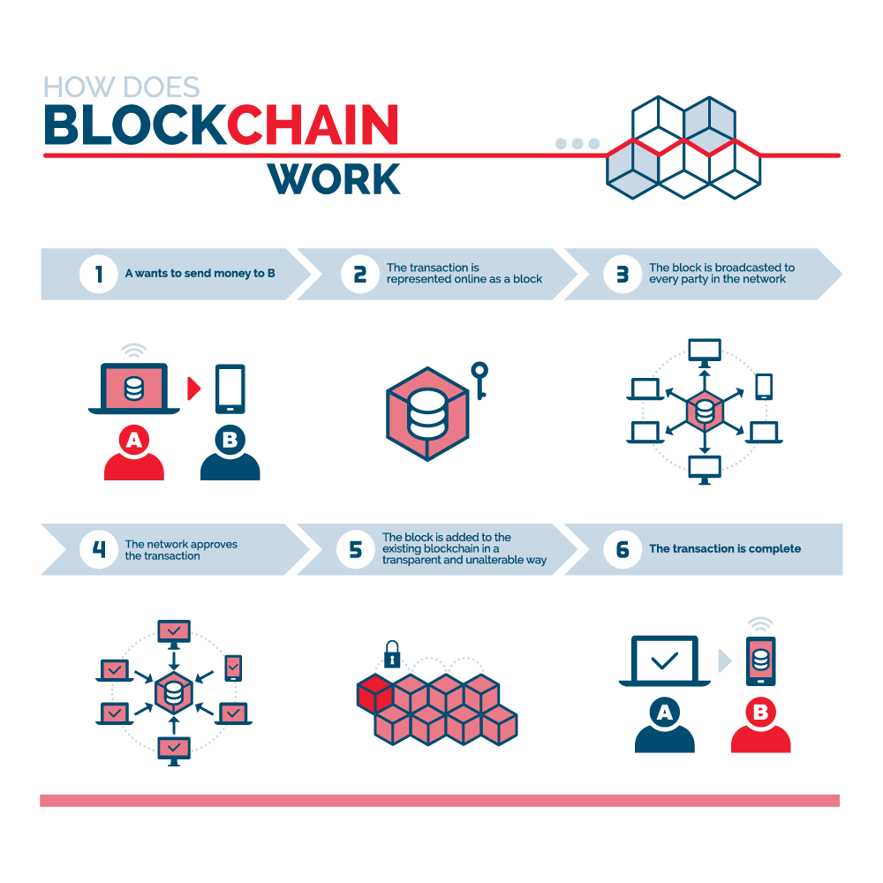
Project Goals & Objectives
Educational Focus:
Designed for educational purposes to enhance understanding of blockchain concepts.
Key Components:
Blocks:
Fundamental units containing transaction data.
Blockchain:
A chain of blocks, linked using cryptographic hashes.
Wallets:
Objects storing and managing user balances.
Transactions:
Exchanges of value between wallets.
Hands-On Learning:
Provides a practical and interactive experience.
Demonstrates the interaction between transactions, blocks, and wallets.
Educational Objectives:
Showcase real-world applications of blockchain technology.
Illustrate the process of block creation and wallet management.

Slide 5
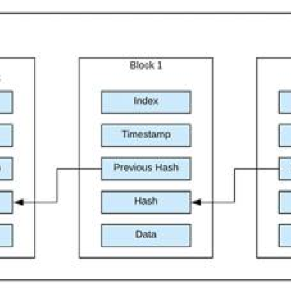
Blockchain Components
Block Class:
Attributes:
Index
Previous Hash
Timestamp
Data
Hash
Sender (Optional)
Receiver (Optional)
Block Interconnection:
Blocks are linked in a chain, creating a chronological sequence of transactions.
Each block's hash is based on the previous block's information.
Block Information:
Index:
Unique identifier for each block.
Previous Hash:
Cryptographic hash of the previous block.
Timestamp:
Time of block creation.
Data:
Details of the transaction or record.
Hash:
Cryptographic hash of the block's information.
Sender and Receiver:
(Optional) Information about the sender and receiver in a transaction.

Slide 6
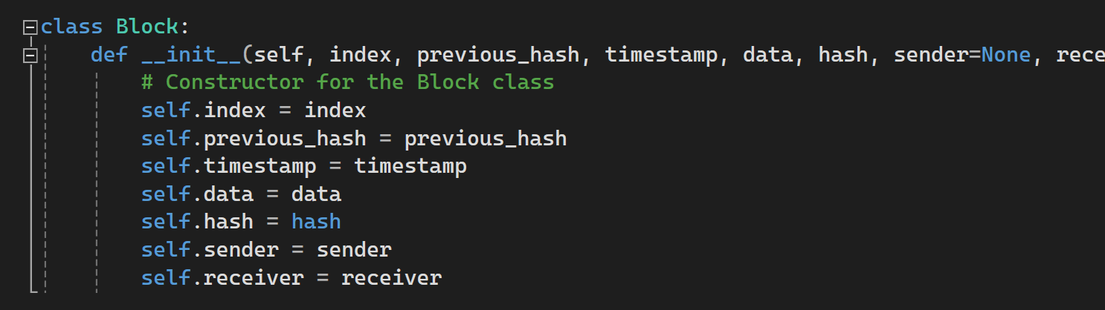
Block Class
Block Class Overview:
The Block class is a fundamental building block within a blockchain system.
Attributes:
Index:
A unique identifier for each block in the blockchain.
Previous Hash:
The cryptographic hash of the previous block, establishing the chain's integrity.
Timestamp:
Represents the time when the block is created.
Data:
Details of the transaction or record stored within the block.
Hash:
The cryptographic hash of the block's information.
Sender and Receiver:
(Optional) Information about the sender and receiver in a transaction.
Block Interconnection:
Blocks are linked in a sequential chain.
The hash of each block is based on the previous block's information, creating a secure and verifiable connection.
Purpose of Each Attribute:
Index:
Identifies the block's position in the blockchain.
Previous Hash:
Ensures the integrity and continuity of the blockchain.
Timestamp:
Records the time of the block's creation for chronological order.
Data:
Stores transaction details or relevant information.
Hash:
Secures the block's information using cryptographic hashing.
Sender and Receiver:
(Optional) Identify the participants in a transaction.
Demonstration in Code:
Showcase a code snippet illustrating the structure and attributes of the Block class.
Emphasize the significance of each attribute in maintaining the blockchain's integrity.

Slide 7
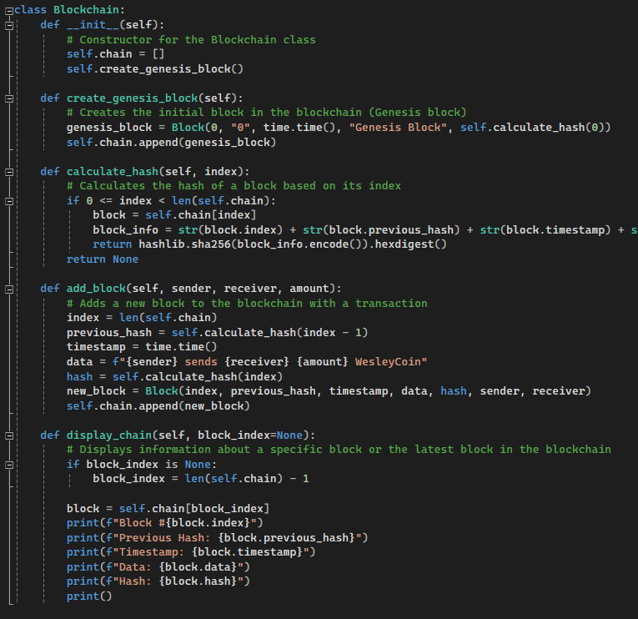
Blockchain Class
Blockchain Initialization:
The Blockchain class is responsible for managing the chain of blocks.
Initialized with the creation of the Genesis block – the first block in the blockchain.
Genesis Block:
The initial block (Block 0) with a predefined hash.
Contains basic information to initiate the blockchain.
Chain Function:
Stores and manages the sequence of blocks.
Grows as new blocks are added to the chain.
Calculate Hash Function:
Computes the hash of a block based on its index.
Utilizes the block's information, including index, previous hash, timestamp, and data.
Add Block Method:
Appends a new block to the chain.
Involves calculating the hash, creating a new block, and updating the blockchain.
Display Chain:
Displays the current block or a specific block of the blockchain

Slide 8
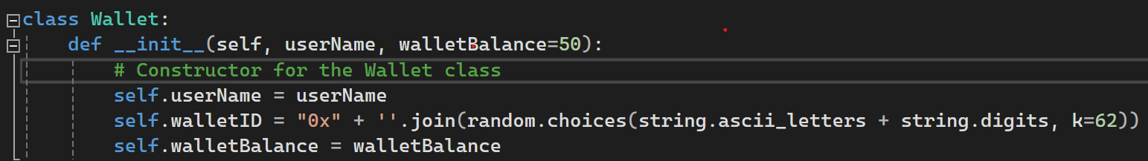
Wallet Class
Wallet Attributes:
userName (private key):
Unique identifier for the wallet owner.
walletID (public key):
Unique identifier for the wallet, often a combination of letters and numbers.
walletBalance:
Represents the amount of WesleyCoin in the wallet.
User-Focused Functionality:
Allows users to interact with the blockchain.
Manages user-specific information such as name, ID, and balance.
Wallet Creation:
Generates a unique wallet ID for each user.
Initializes with a default balance, promoting accessibility for educational purposes.
Transaction Involvement:
Participates in transactions by sending and receiving WesleyCoin.
Wallet balances are updated accordingly.

Slide 9
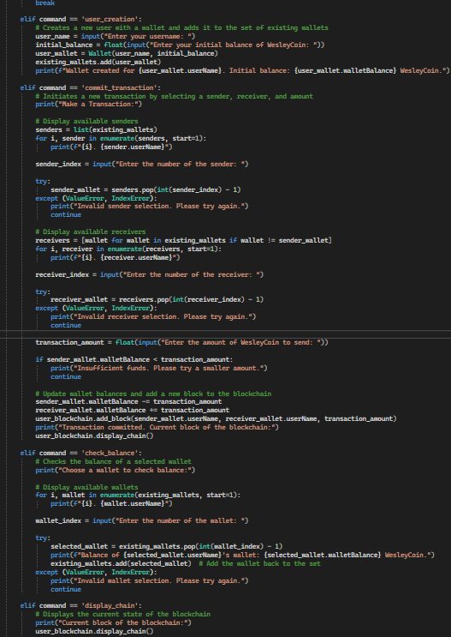
Main Methods & Commands
Available Commands:
user_creation (uc):
Purpose: Create a new user and associated wallet.
Procedure: Enter username and initial balance.
commit_transaction (ct):
Purpose: Initiate a transaction between two wallets.
Procedure: Select sender and receiver, specify the amount to transfer.
check_balance (cb):
Purpose: Check the balance of a specific wallet.
Procedure: Choose a wallet to view the current balance.
display_chain (dc):
Purpose: View the current state of the blockchain.
Procedure: Displays block details, including hash, timestamp, and data.
exit_0:
Purpose: Exit the program.
Procedure: End the execution of the demo.

Slide 10
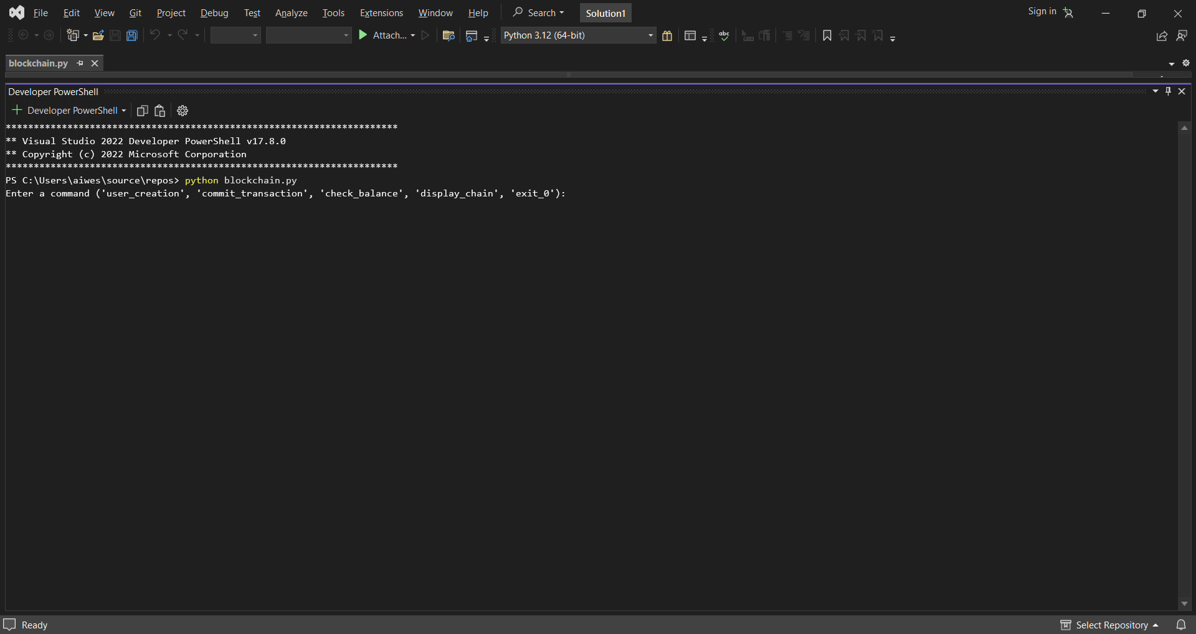
Video Demo

Slide 11

Educational Benefits
Real-World Applications
Hands-On Understanding
User Transactions
Blockchain Concepts
Wallet Creation
Interactive Learning Experience:

Slide 12

Questions about the blockchain?

Slide 13
References
SphereGen
Title: Blockchain Technology Basics
URL: https://www.spheregen.com/blockchain-technology-basics/
ResearchGate
Title: Simplified diagram of a blockchain
URL: https://www.researchgate.net/figure/Simplified-diagram-of-a-blockchain_fig1_332715800
Trenton Systems
Title: Blockchain Explained: The Complete Guide - Part 1
URL: https://www.trentonsystems.com/blog/blockchain-explained-the-complete-guide-part-1
Simplilearn - Blockchain Tutorial
Title: Blockchain Tutorial
URL: https://www.simplilearn.com/tutorials/blockchain-tutorial/blockchain-technology
Simplilearn - Blockchain Wallet
Title: Blockchain Wallet
URL: https://www.simplilearn.com/tutorials/blockchain-tutorial/blockchain-wallet
Visual Studio Code
Title: Visual Studio Code
URL: https://code.visualstudio.com/
Python Official Website
Title: Python
URL: https://www.python.org/

